Slide 1

Panic Button WIP 1
Sarin Iamsangtham
6/29/2017

Slide 2
Overview
Overall Objective
Background Information
Methods
Planned Features
Current Objective
Progress Made
Results
Remaining Tasks
References

Slide 3
Overall Objective
Create an application for smartphones which:
Sends at least a text message to a list of emergency contacts
Does so upon Bluetooth button press

Slide 4
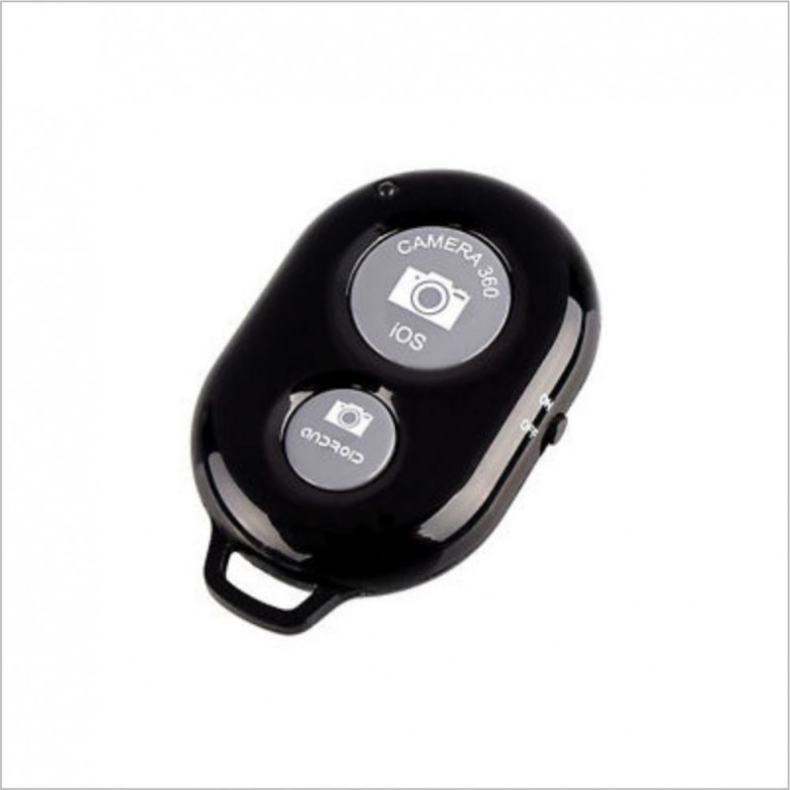
Background Information
Safety App
Developed in Java
On Android Studio
Features tested on
Android Studio
a Virtual Device
a ZTE ZMAX
Laptop as BT device
Figure 1: Button model to be used in project

Slide 5
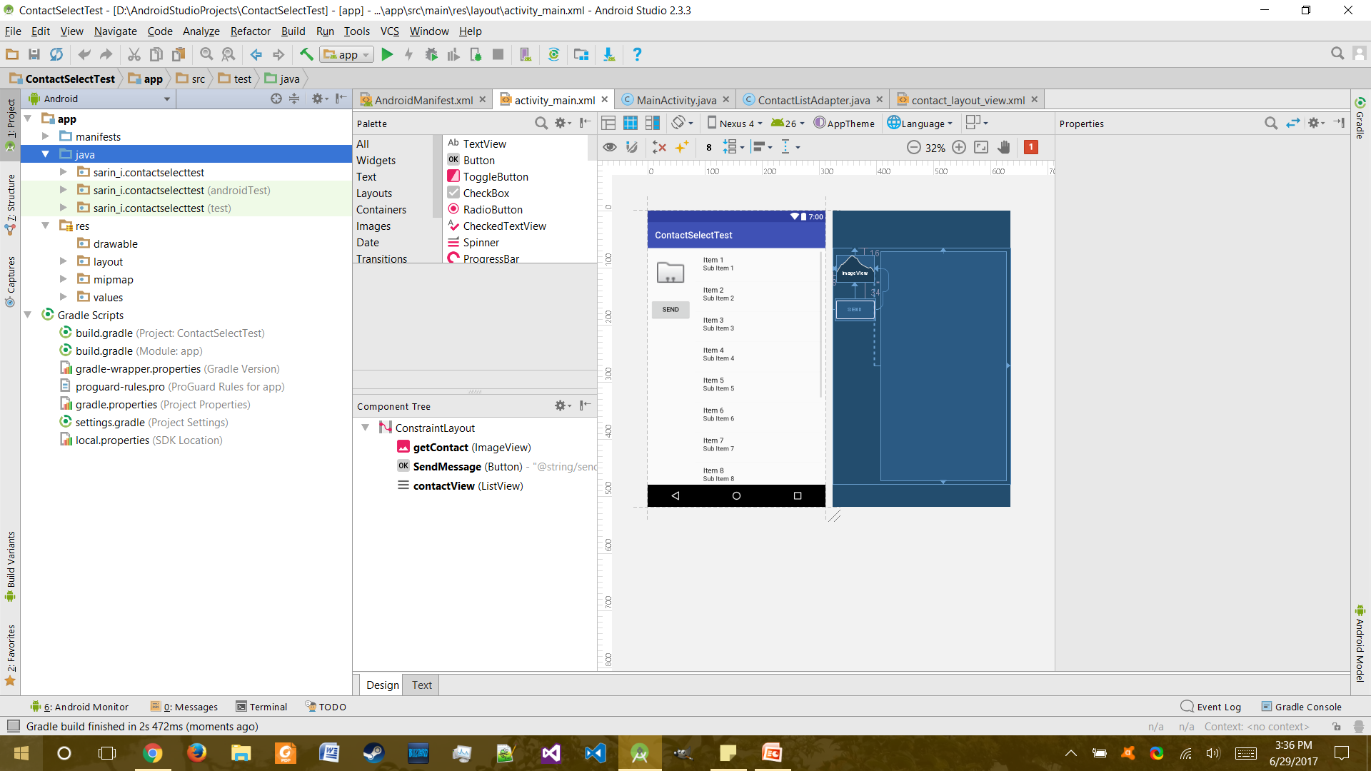
Background Information
Figure 2: Screenshot of Android Studio

Slide 6
Methods
Android Studio
Java-based language
Used for Android development
Comes with an emulator/Gradle integration
Language different from iOS dev
Easier to get apps published compared to iOS
Easier to work with compared to Eclipse
Don’t own any Apple products

Slide 7
Methods
Make apps of single features
Features mimic those needed in final app
Combine parts of apps into other apps
Functionalities eventually come together
Currently the way I learn
Some features may take a while

Slide 8
Planned Features
Android/iOS compatibility
Emergency contacts will be sent
Text message
Location information
Ability to add and remove contacts
Usability in phone’s sleep mode
Bluetooth Button press will activate functions

Slide 9
Current Objectives
Android Compatibility
Mass text implementation
Bluetooth Button compatibility implementation
Adding and removal of contacts
Make it look half-decent

Slide 10
Progress Made
Android Studio Basics
Views, Listeners, etc.
Learned about connecting Bluetooth devices to Android
Learned how to send SMS messages using Android Studio
Lots of test/tutorial apps
Started a pre-prototype with some ideas

Slide 11
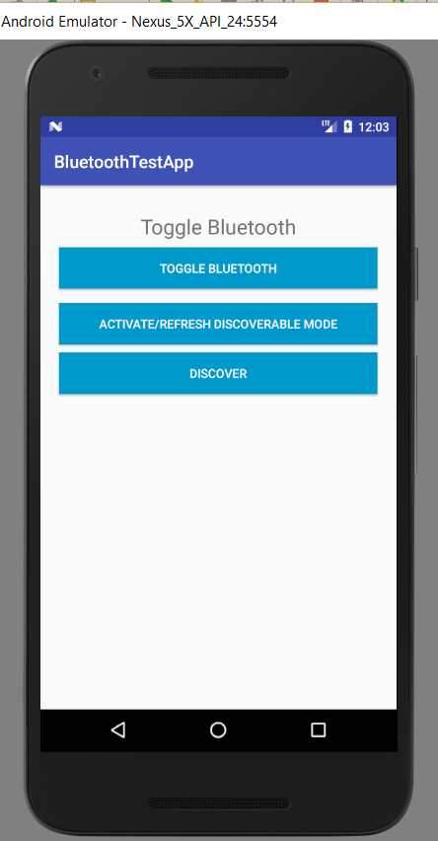
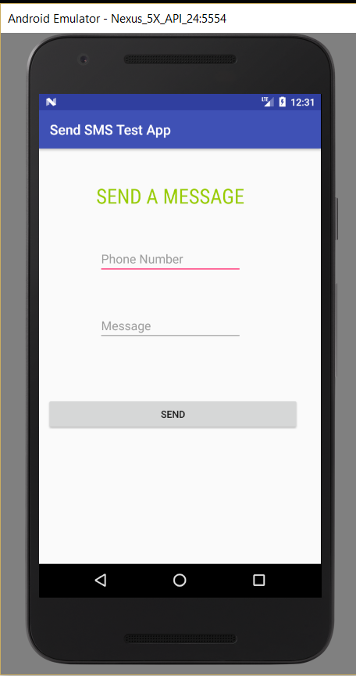
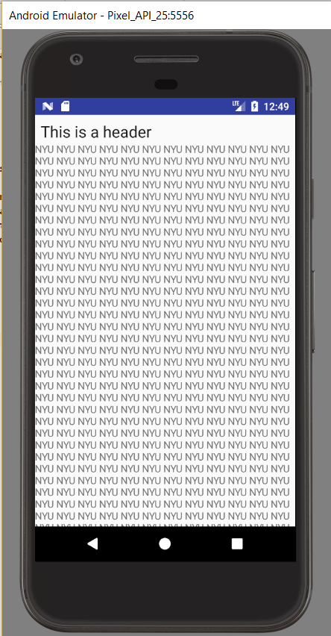
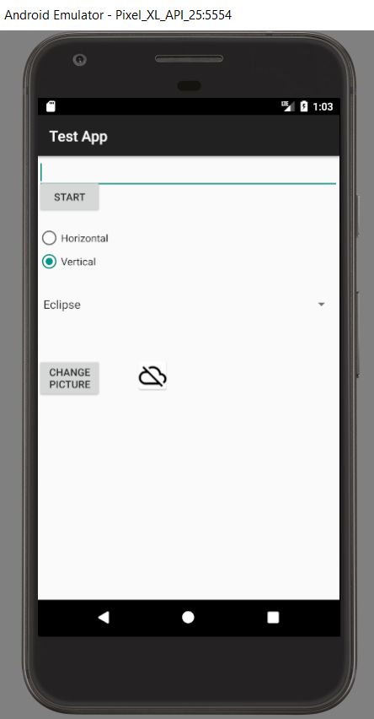
Progress Made
Figures 3-6: Some Test App screenshots
Notes:
Add pictures of various test/tutorial apps here

Slide 12
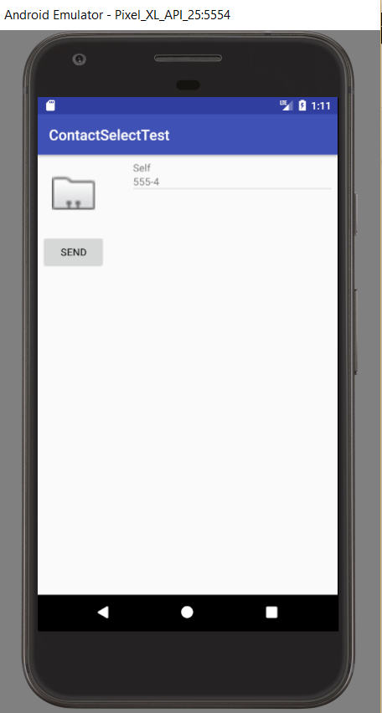
Progress Made
Select Contact
Contacts Listed Here
Click a contact to delete it
Send Message
Figure 7: Pre-prototype screenshot
Notes:
Picture of rudimentary app

Slide 13
Results
Understand Android Studio more
Can add contacts to app
List of contacts is displayed to user
App can send mass text to contacts
Contacts can be deleted on press/click

Slide 14
Remaining Tasks
Improve functionalities of current pre-prototype
Maintain contacts between app openings
Learn how to read Bluetooth device inputs
Learn how to integrate BT devices in apps
Add more notification types besides SMS
Make it look more half-decent

Slide 15
References
Rajput, M. (2015, August 17). Why Android Studio Is Better For Android Developers Instead Of Eclipse - DZone Mobile. Retrieved June 28, 2017, from https://dzone.com/articles/why-android-studio-better
Sinicki, A. (2016, June 09). Developing for Android vs developing for iOS - in 5 rounds. Retrieved June 28, 2017, from http://www.androidauthority.com/developing-for-android-vs-ios- 697304/

